Slide 1



Presented by
Group 4
Natural Resources of Bangladesh

Slide 2

02
Group Member

Slide 3

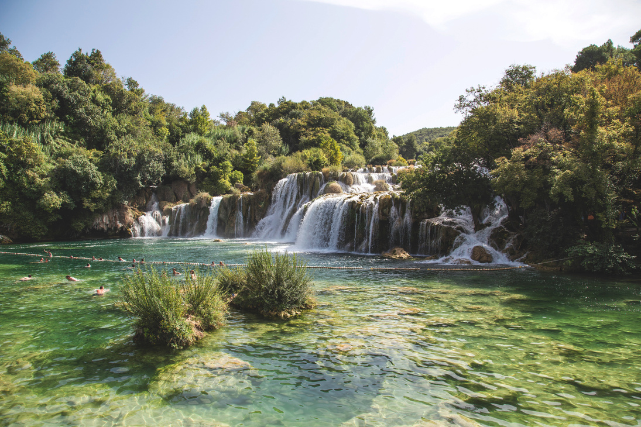


03
Introduction
Bangladesh is rich in natural resources
These resources support economy & livelihood
Main types: renewable & non-renewable
Bangladesh is a naturally blessed country with various resources like land, water, forests, and minerals. These resources play a vital role in our economy and daily life. Natural resources are mainly divided into renewable and non-renewable resources. In this presentation, we will discuss the major natural resources of Bangladesh and their importance.

Slide 4



04
Land & Water Resources
Land Resources
Fertile soil
Agriculture-based economy
Main crops: rice, jute, wheat
Water Resources
Rivers: Padma, Meghna, Jamuna
Fisheries sector
Irrigation for farming
Bangladesh has very fertile land, which is ideal for agriculture. Most people depend on farming, producing crops like rice and jute. Water is another important resource. The country has many rivers, which help in irrigation, transportation, and fishing. Fisheries also contribute significantly to the economy.

Slide 5
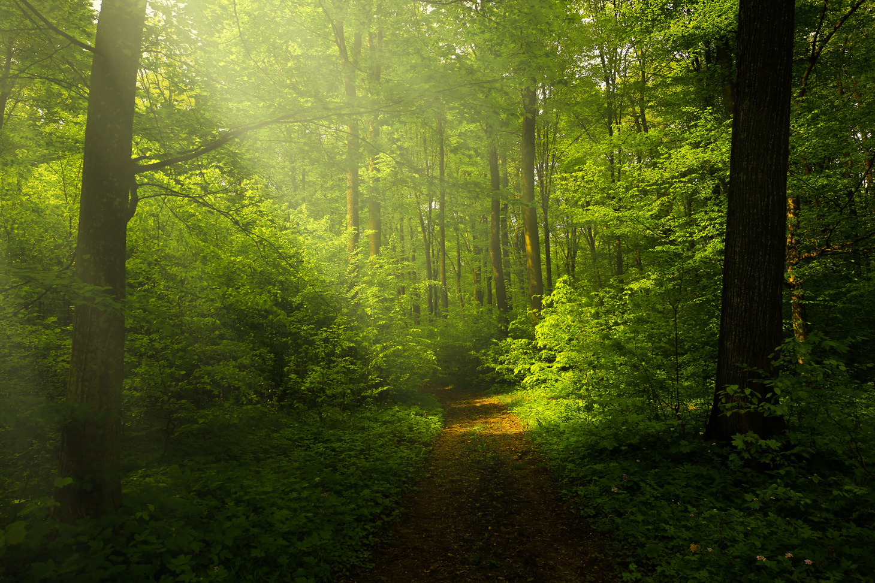

05
Forest & Wildlife
Forest Resources
Sundarbans (largest mangrove forest)
Timber and wood
Medicinal plants
Forests are an important natural resource in Bangladesh. The Sundarbans is the largest mangrove forest in the world and provides wood, honey, and other resources. It also protects us from natural disasters. Wildlife is also important, including the famous Royal Bengal Tiger. Protecting biodiversity is essential for ecological balance.
Wildlife Resources
Royal Bengal Tiger
Deer, birds, reptiles
Importance of biodiversity

Slide 6



06
Mineral & Energy Resources
Mineral Resources
Natural gas (main resource)
Coal
Limestone
Energy Resources
Natural gas-based energy
Renewable energy (solar, wind)
Future potential
Bangladesh has several mineral resources, especially natural gas, which is the main energy source. Coal and limestone are also found in some areas. Energy is very important for development. Recently, Bangladesh is focusing on renewable energy like solar and wind power to ensure sustainability.

Slide 7



07
Problems & Conclusion
Problems & Challenges
Overpopulation
Environmental pollution
Deforestation
Climate change
Conclusion
Proper management is necessary
Sustainable use of resources
Government & public awareness
Despite having many natural resources, Bangladesh faces several challenges such as overpopulation, pollution, and deforestation. Climate change also affects our resources. Therefore, we must use these resources wisely. Proper management and awareness are essential to ensure a sustainable future.

Slide 8

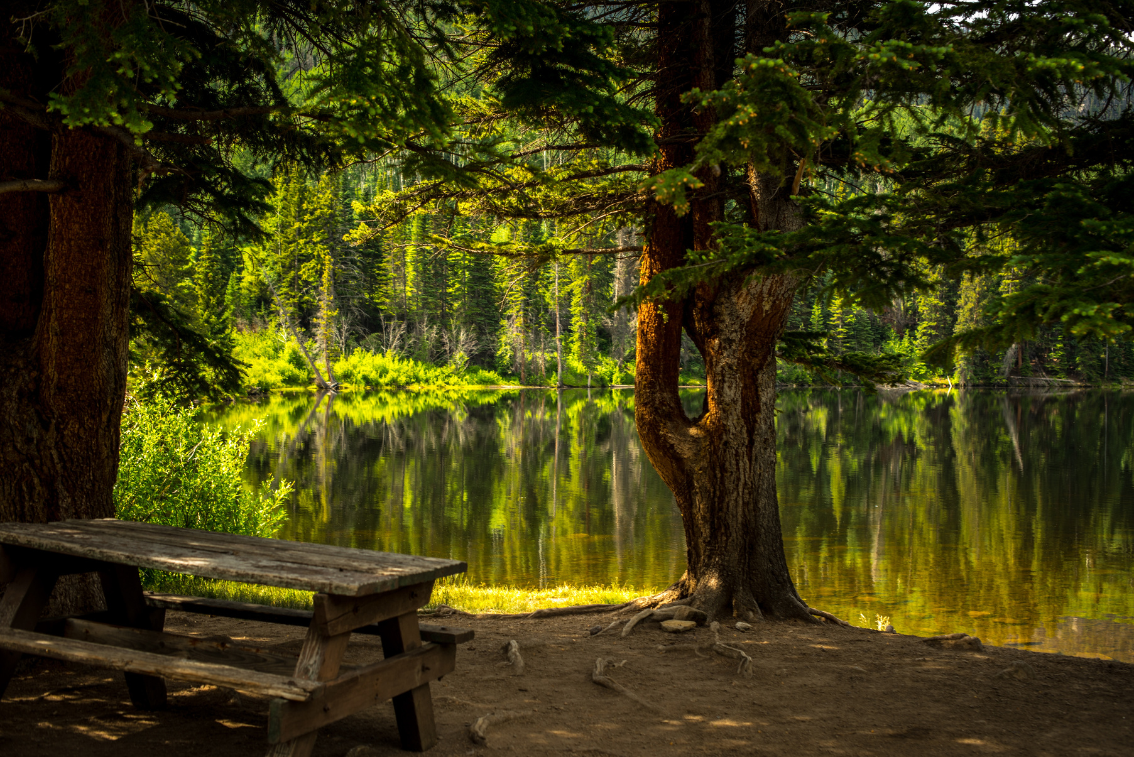
08
Thank You!

